Slide 1
Deep Dive into Office 365 with the Microsoft Graph API for Contacts

Slide 2
Deep Dive into Office 365 with the Microsoft Graph API for Contacts

Slide 3
Agenda
Overview
CRUD support
Batching support
Exchange operations using REST

Slide 4
Developer vision

Slide 5
1
Overview

Slide 6
Microsoft Graph for Calendar, Mail and Contacts
Microsoft Graph
Mail Messages
Contacts
Calendar Events
Microsoft Graph accessible through REST
https://graph.microsoft.com/v1.0/me/messages
https://graph.microsoft.com/v1.0/me/contacts
https://graph.microsoft.com/v1.0/me/events

Slide 7
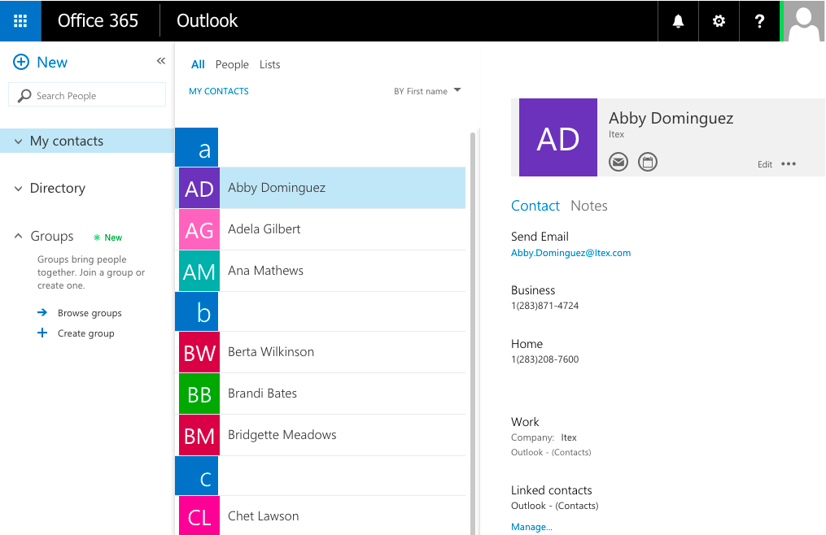
Mailbox contacts
Common API operations
Creating contacts
Deleting contacts
Editing contacts

Slide 8
2
CRUD support

Slide 9
Getting and deleting a specific entity
Contact retrieved by calling GetAsync()
Contact deleted by calling DeleteAsync on contact object
public async Task<MyContact> GetContact(string id)
{
try
{
var graphServiceClient = await GetGraphServiceAsync();
var requestContact = await graphServiceClient.Me.Contacts[id].Request().GetAsync();
var contactResult = new MyContact
{
Id = requestContact.Id,
GivenName = requestContact.GivenName,
Surname = requestContact.Surname,
CompanyName = requestContact.CompanyName,
EmailAddress = requestContact.EmailAddresses.Count() > 0 ? requestContact.EmailAddresses.First().Address : string.Empty,
BusinessPhone = requestContact.BusinessPhones.Count() > 0 ? requestContact.BusinessPhones.First() : string.Empty,
HomePhone = requestContact.HomePhones.Count() > 0 ? requestContact.HomePhones.First() : string.Empty
};
return contactResult;
}
catch (Exception el)
{
return null;
}
}
public async Task DeleteContact(string id)
{
try
{
var graphServiceClient = await GetGraphServiceAsync();
await graphServiceClient.Me.Contacts[id].Request().DeleteAsync();
}
catch (Exception el)
{
}
return;
}

Slide 10
Adding an entity
public async Task AddContact(MyContact myContact)
{
try
{
var graphServiceClient = await GetGraphServiceAsync();
var requestContact = new Microsoft.Graph.Contact
{
GivenName = myContact.GivenName,
Surname = myContact.Surname,
CompanyName = myContact.CompanyName,
};
var emailList = new List<EmailAddress>();
emailList.Add(new EmailAddress { Address = myContact.EmailAddress, Name =
myContact.EmailAddress });
requestContact.EmailAddresses = emailList;
var businessPhonesList = new List<string>();
businessPhonesList.Add(myContact.BusinessPhone);
requestContact.BusinessPhones = businessPhonesList;
var homePhonesList = new List<string>();
homePhonesList.Add(myContact.HomePhone);
requestContact.HomePhones = homePhonesList;
await graphServiceClient.Me.Contacts.Request().AddAsync(requestContact);
}
catch (){}
return;
}
Call AddAsync() on contacts collection

Slide 11
Update operations with the OutlookServicesClient
3 CRUD support
demo

Slide 12
3
Batching with REST

Slide 13
REST is more chatty than CSOM
Each action is sent as a separate request
CSOM allows for multiple requests to be sent as one
Requests are expensive and slow your app

Slide 14
Batching support added to O365
Office 365 REST APIs shipped with support for support with REST APIs
Batching requests with REST support added to SharePoint Online late 2014
Send multiple write & read operations in one HTTP request
SharePoint 2013 on-premises——not supported

Slide 15
Exploring the impact

Slide 16
Overview—Batch request
BATCH REQUEST
CHANGESET – HTTP POST
CHANGESET – HTTP PATCH
CHANGESET – HTTP DELETE
HTTP GET

Slide 17
Overview—Batch response
BATCH RESPONSE
CHANGESET RESPONSE
CHANGESET RESPONSE
CHANGESET RESPONSE
HTTP GET RESPONSE

Slide 18
4
Exchange operations with REST

Slide 19
Microsoft Graph
https://graph.microsoft.com/v1.0/me/drive/root/children
https://graph.microsoft.com/v1.0/me/messages
https://graph.microsoft.com/v1.0/me/events
https://graph.microsoft.com/v1.0/me/events(<event_id>)
https://graph.microsoft.com/v1.0/me/calendar
https://graph.microsoft.com/v1.0/me/calendar/events
https://graph.microsoft.com/v1.0/me/calendars(<calendar_id>)/events
https://graph.microsoft.com/v1.0/me/contacts
https://graph.microsoft.com/v1.0/me/contacts(<contact_id>)

Slide 20
Exchange operations using the Office 365 REST APIs
4 Exchange operations with REST
demo

Slide 21
Summary
Overview
CRUD support
Batching support
Exchange operations using REST

Slide 22
Developer Program launch
1 YEAR FREE
Email Newsletters
Free Developer Subscription
Free Training
Free Tools
Webinars
http://dev.office.com/devprogram

Slide 23
Engage

